Slide 1


Rockbuster Stealth Data Analysis
Presented by: Mercy Tsekiri
Date:31th May, 2022

Slide 2

Objective
This presentation is intended to provide insights that will help launch the new online video rental service.

Slide 3

Key Business Questions
Which movies contributed the most/least to revenue gain?
What was the average rental duration for all videos?
Which countries are Rockbuster customers based in?
Where are customers with a high lifetime value based?
Do sales figures vary between geographic regions?

Slide 4









Key Metrics
No. of films
1000
No. of customers
599
No. of orders 14,596
Total revenue
$61,312
Repeat purchase rate
100%
Popular rating
PG-13
Duration of sales
10 months
Film language
English

Slide 5
Data Overview
Min rental duration
3
Max rental duration
7
Average rental duration
5
Max rental rate
0.99
Max rental rate
4.99
Average rental duration
2.99
Min film length
46
Max film length
185
Average film length
115
Min replace-
ment cost
$9.99
Max replace-
ment cost
$29.99
Avg replace-
ment cost
$19.98

Slide 6
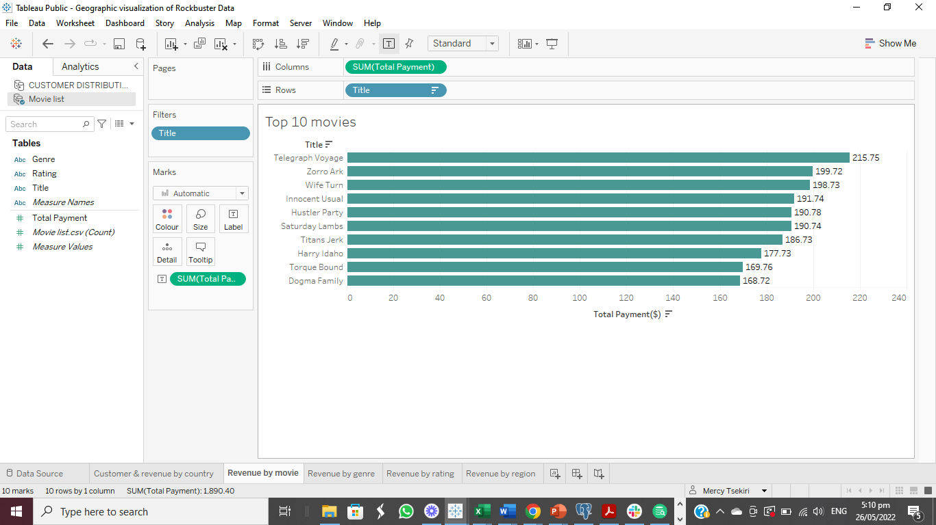

Top ten movies(by revenue)

Slide 7

List of movies that did not generate any revenue
Alice Fantasia
Apollo Teen
Argonauts Town
Ark Ridgemont
Arsenic Independence
Boondock Ballroom
Butch Panther
Catch Amistad
Chinatown Gladiator
Chocolate Duck
Commandments Express
Crossing Divorce
Crowds Telemark
Crystal Breaking
Dazed Punk
Deliverance Mulholland
Firehouse Vietnam
Floats Garden
Frankenstein Stranger
Gladiator Westward
Gump Date
Hate Handicap
Hocus Frida
Kentuckian Giant
Kill Brotherhood
Muppet Mile
Order Betrayed
Pearl Destiny
Perdition Fargo
Psycho Shrunk
Raiders Antitrust
Rainbow Shock
Roof Champion
Sister Freddy
Sky Miracle
Suicides Silence
Tadpole Park
Treasure Command
Villain Desperate
Volume House
Wake Jaws
Walls Artist
42 movies were not rented hence did not generate any revenue. Further analysis would be done to determine why.

Slide 8
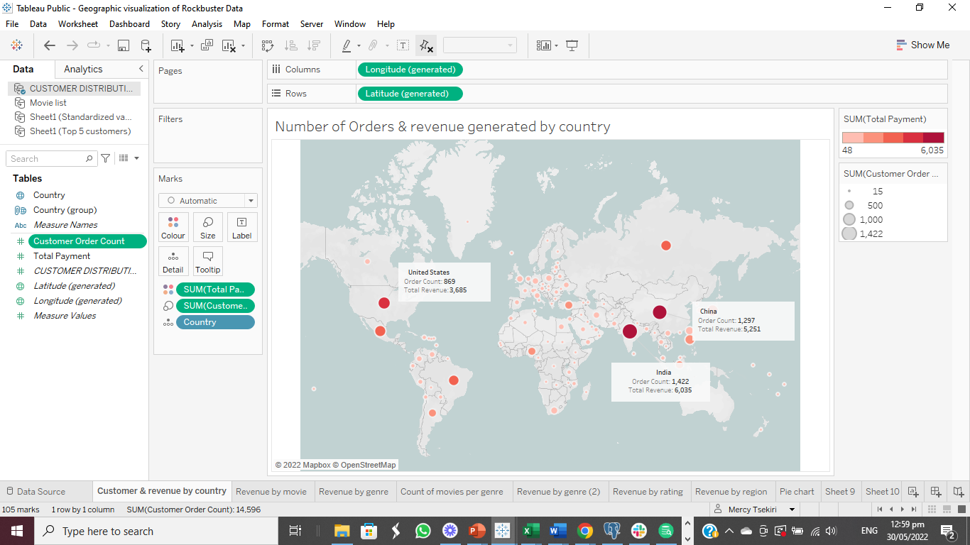
Number of orders & revenue generated by country
Rockbuster’s customers are located across 108 countries.
The annotation on the map shows the top 3 countries with the highest customer orders and revenue.
The size of the bubble represents the number of orders while the colour represents the revenue.

Slide 9

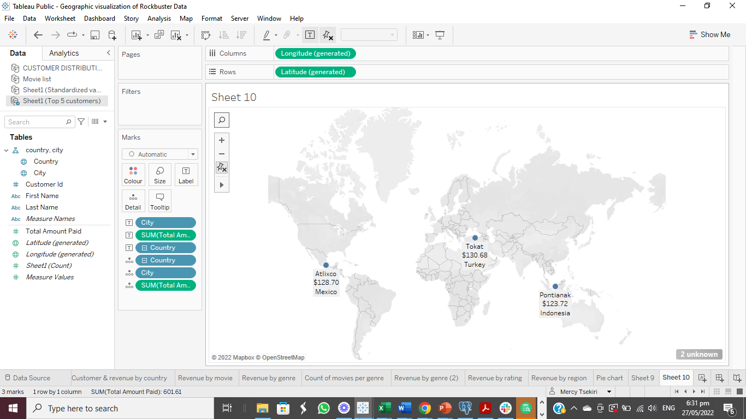
Location of Top Customers
These are the location of the top 3 customers that spent the most.

Slide 10
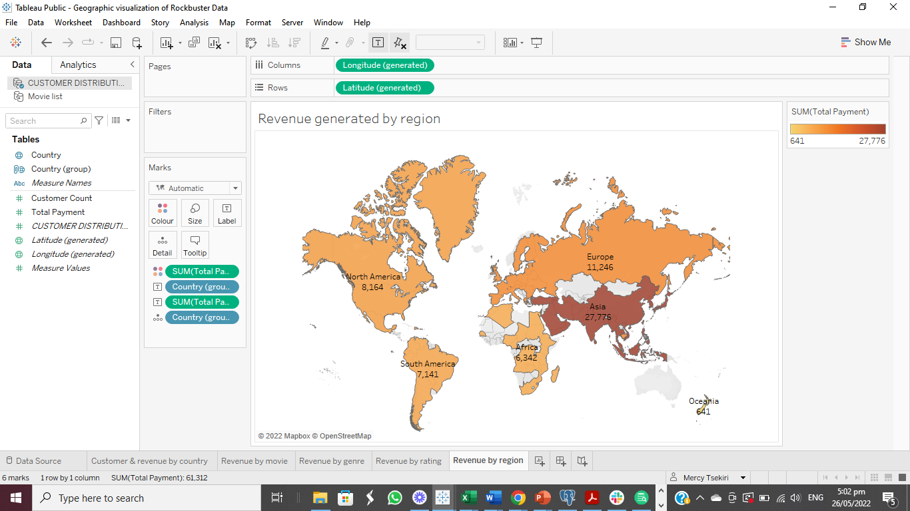
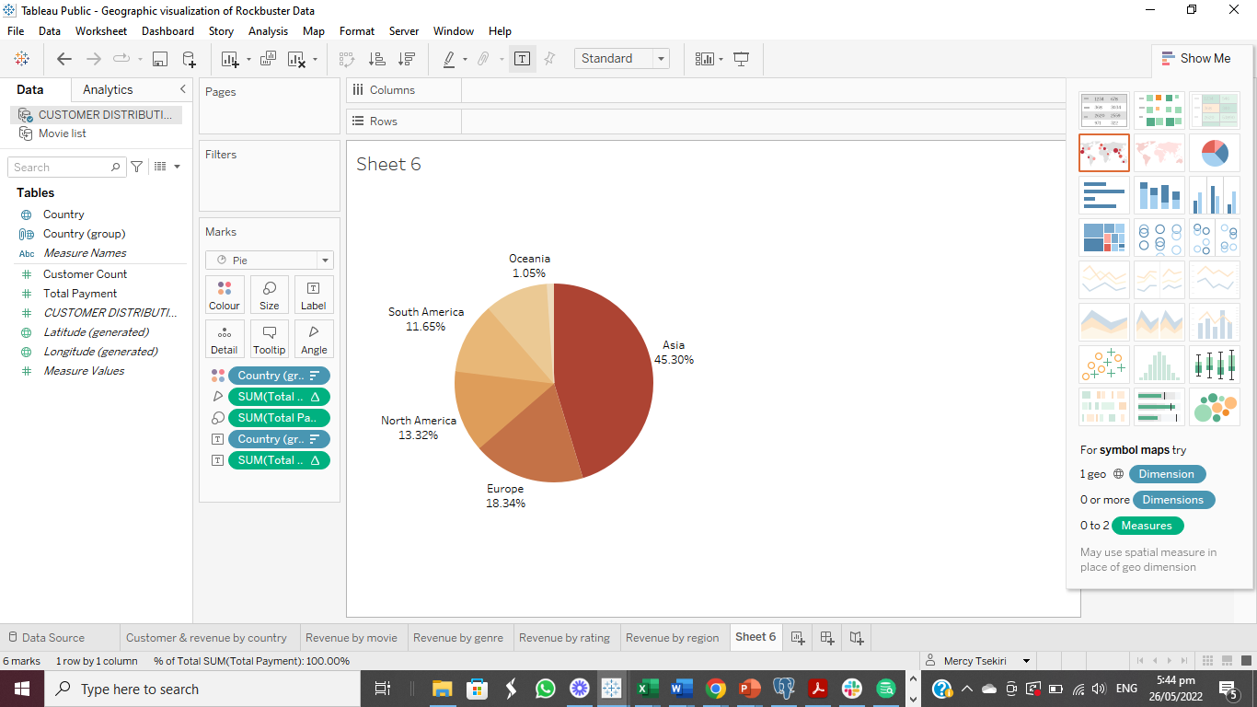
Revenue by region
Asia has the most sales which accounts for 45% of the total revenue.

Slide 11
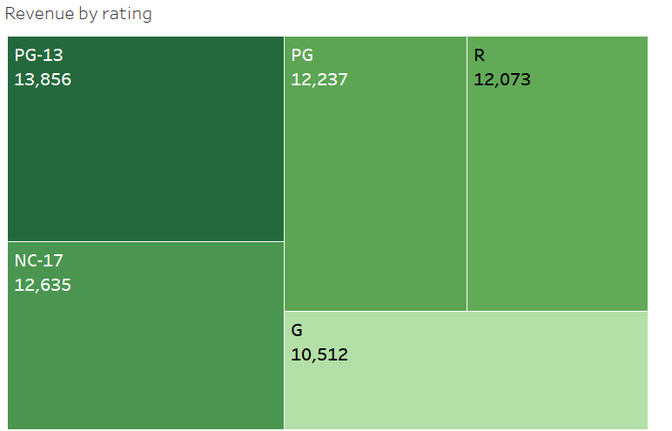
Revenue by rating
Though PG-13 generated the most revenue, there isn’t much variability among the ratings.

Slide 12
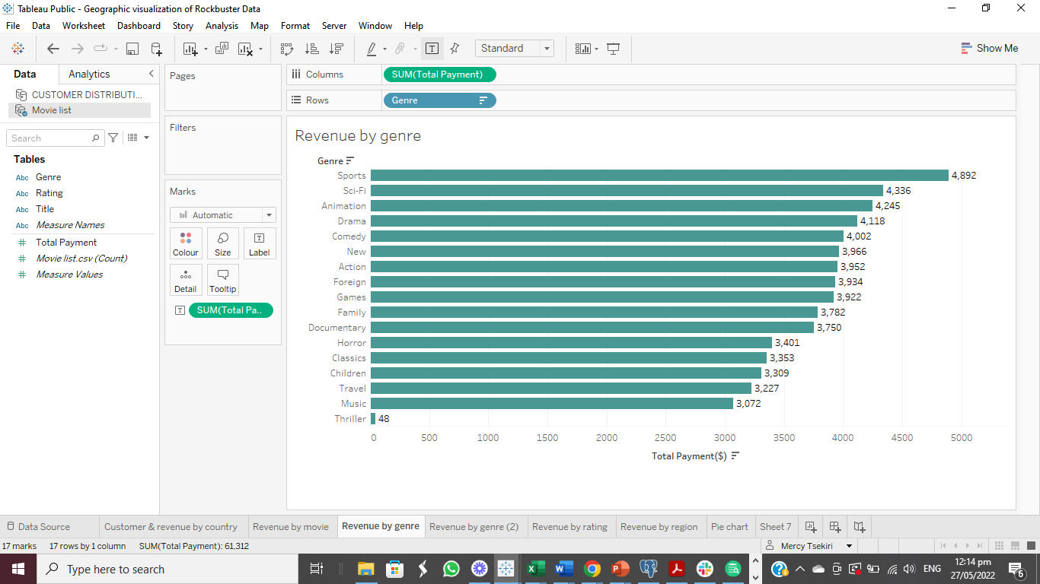
Revenue by Genre
Sports generated the most revenue and surprisingly Thriller generated the least revenue. This could be as a result of the number of available movies in each genre.

Slide 13
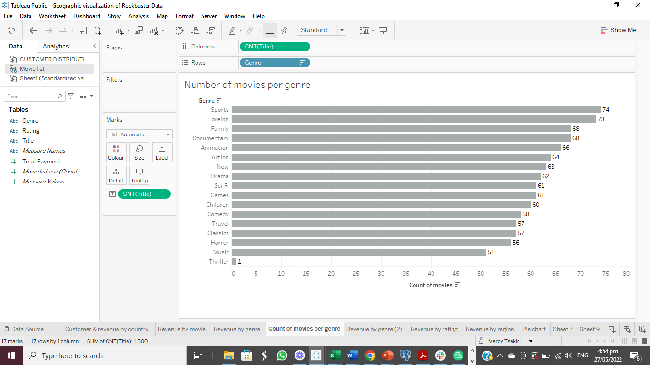
Number of Movies per Genre
Sports has the most movies while Thriller has the least movies.
Like earlier mentioned, number of movies could be linked to revenue generated per genre. Further analysis was done to ascertain if there exist a positive relationship between both variables.

Slide 14
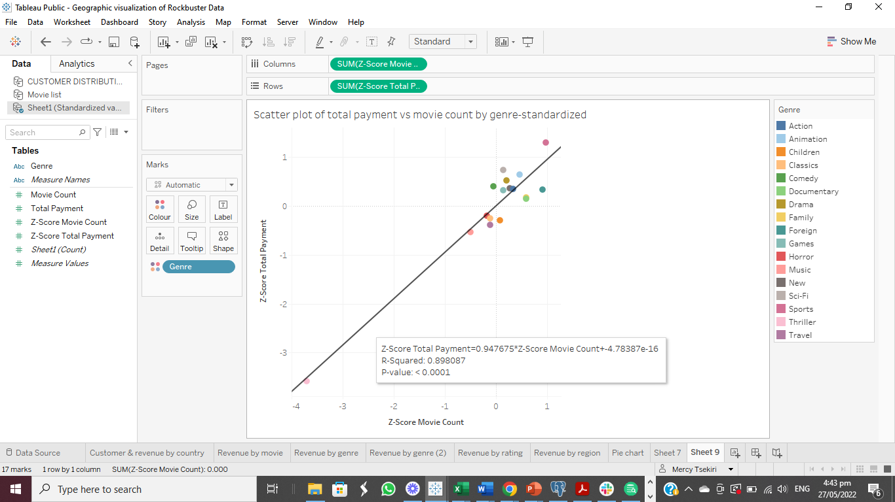
Results from statistical analysis
Further analysis, reveals that there’s a strong positive relationship between number of movies available per genre and revenue generated per genre. Also, the relationship is statistically significant at 95% confidence level.

Slide 15
Recommendation
With respect to the online video rental service, here are my recommendations;
Ad campaigns should be targeted at top continents, countries and cities.
Analysis has shown that increase in number of available movies leads to an increase in revenue. Hence, more movies should be made available in the different genres. Data should be collected to know what kind of movies customers like.
Top movies should be prioritized to increase revenue.

Slide 16
Recommendation Cont’d
Foreign films should be made available since 45% of the customers are from Asia.
The collection of films should be expanded to increase the client base as only film released in 2006 are currently available.

Slide 17
Next Steps
A survey will be sent to customers regarding the 42 movies that were never rented. The data will be analysed to determine why and the way forward. This could help save and generate money for the company.
All existing and potential customers will be notified about the new online rental service and feedback will be obtained on how to make the experience more exciting.
Sales channels will be identified e.g monthly subscription, purchase per film etc.
Analysis will be done three months into the implementation of the new service to determine key business metrics and monitor its progress. The results should identify areas for improvement and help make critical decisions.

Slide 18

THANK YOU
Please see link to visualizations: https://public.tableau.com/app/profile/mercy.tsekiri/viz/VisualizationofRockbusterData/Revenuebyrating?publish=yes

